Slide 1
End-to-End E-Commerce
Data Science Analysis and Machine Learning on Flipkart
Product Data
MUHAMMED ASHIF T
DA&DS
AUGUST-2025

Slide 2
Project Overview
This capstone project focuses on analyzing real-world
e-commerce product data scraped from the Flipkart website. The objective is to understand product trends, customer preferences, and performance patterns using data science techniques. The project covers the complete data science lifecycle, including data collection, cleaning, storage, exploratory analysis, unsupervised learning, supervised learning, and hyperparameter tuning to derive actionable business insights.

Slide 3
Problem Statement
Flipkart provides extensive product data, but it is available in raw and unstructured form, making analysis challenging. This project scrapes and structures Flipkart product data and applies machine learning to uncover trends, classify products, and support data-driven product and marketing decisions

Slide 4
Data Collection Web Scraping
Source:
Flipkart E-Commerce Website
Tools & Technologies
  Python
  BeautifulSoup / Requests
  Pandas
Data Scraped
  Product Name
  Price
  Category
  Ratings
  Number of Reviews
The data was scraped ethically while respecting website structure and usage policies, and stored in CSV format for further processing.

Slide 5
Data Cleaning & Preprocessing
After loading the scraped data into a Pandas DataFrame, the following steps were performed:
  Handled missing values and inconsistent records
  Removed duplicate and irrelevant entries
  Standardized currency symbols and numerical formats
  Converted text data to consistent casing

Slide 6
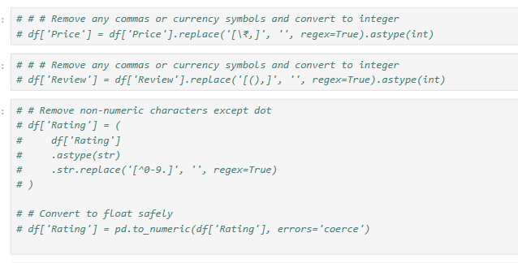
Data Cleaning

Slide 7
Exloratory Data Analysis(EDA)
  Performed Exploratory Data Analysis (EDA) to study:
    Price distribution
    Rating trends
    Category-wise product distribution
    Review count patterns
EDA helped identify outliers, popular categories, and highly rated products.

Slide 8
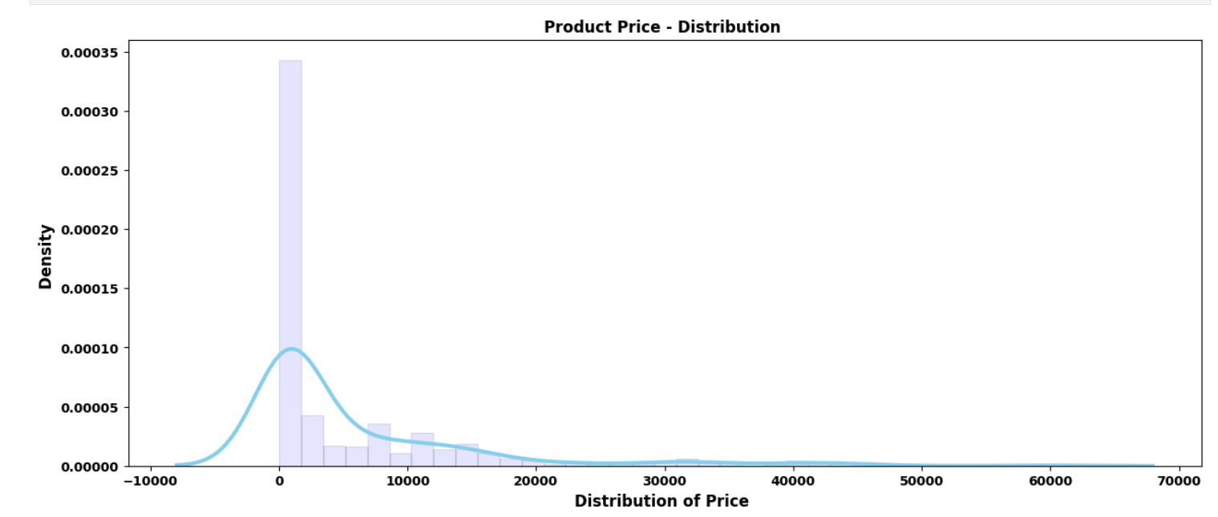
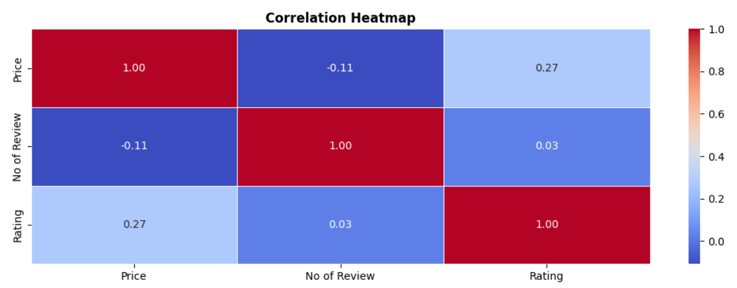
Price Distribution
Correlation Heatmap

Slide 9
Data Storage
  A relational database was created using SQLAlchemy
  Cleaned data was stored in structured tables
  Enabled efficient querying and reuse of data for modeling

Slide 10
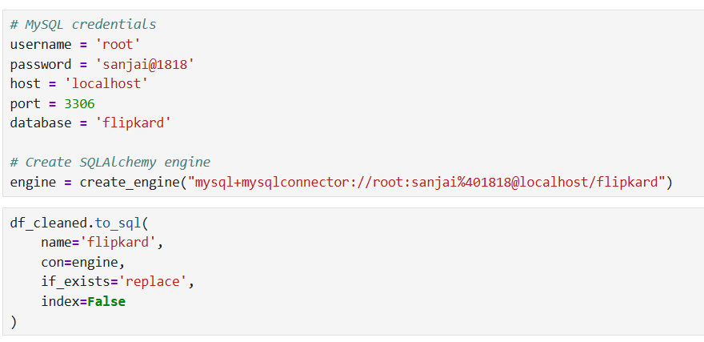

Slide 11
Unsupervised Learning (Clustering)
Technique Used
  K-Means Clustering
Process
  Selected relevant numerical features
  Tested multiple cluster values using the Elbow Method
  Assigned cluster labels to each product
Outcome
  Grouped similar products based on price, ratings, and reviews
  Helped identify premium, mid-range, and budget product clusters

Slide 12
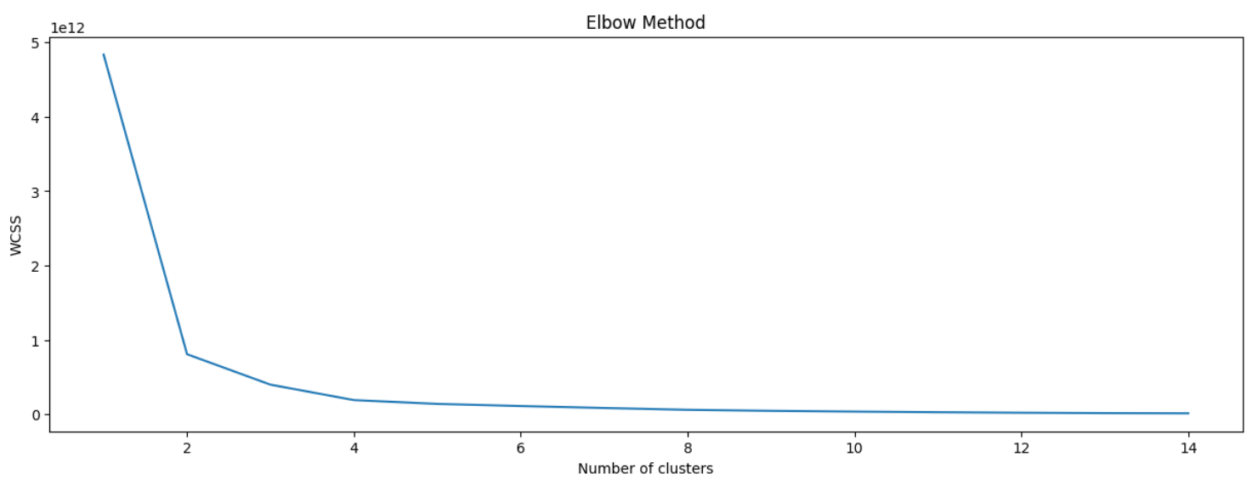
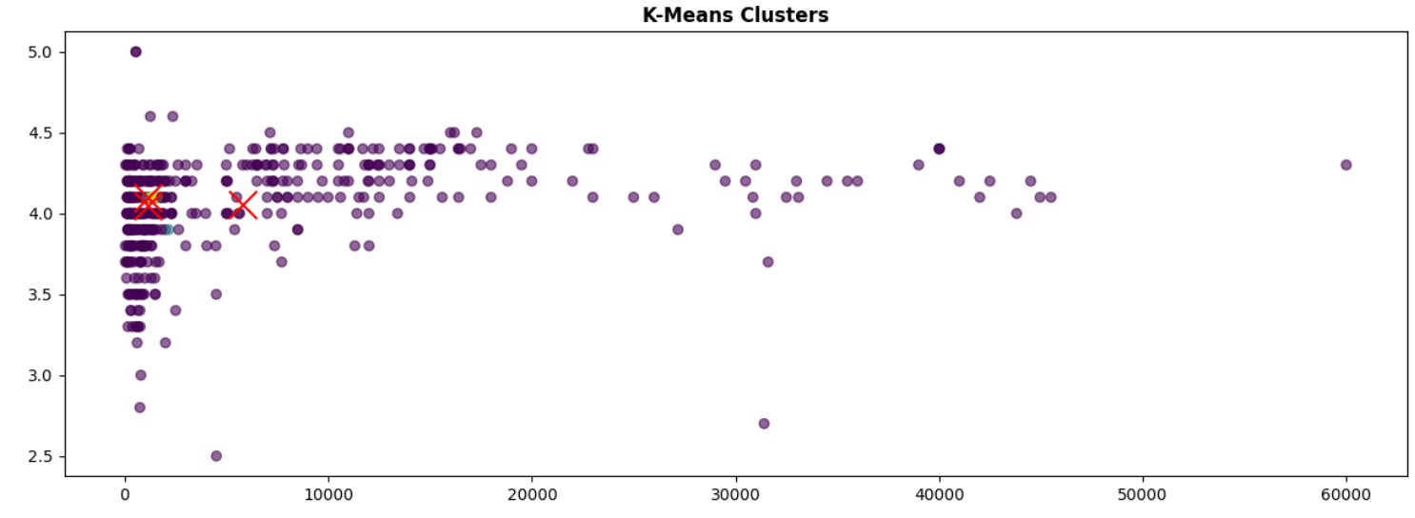
Elbow Method
K- Means Clusters

Slide 13
Multiple classification models were implemented to predict product categories or labels.
Models Used
  Logistic Regression
  Support Vector Machine (SVM)
  k-Nearest Neighbors (k-NN)
  Random Forest
  XGBoost
Supervised Learning

Slide 14
Evaluation Metrics
  Accuracy
  Precision
  Recall
  F1 Score
Random Forest performed best initially with ~93% accuracy.
Supervised Learning

Slide 15
Thank You !

